Slide 1
Introduction to Big Data Systems
Lecture 1. Course introduction
Wenguang CHEN
Tsinghua University

Slide 2
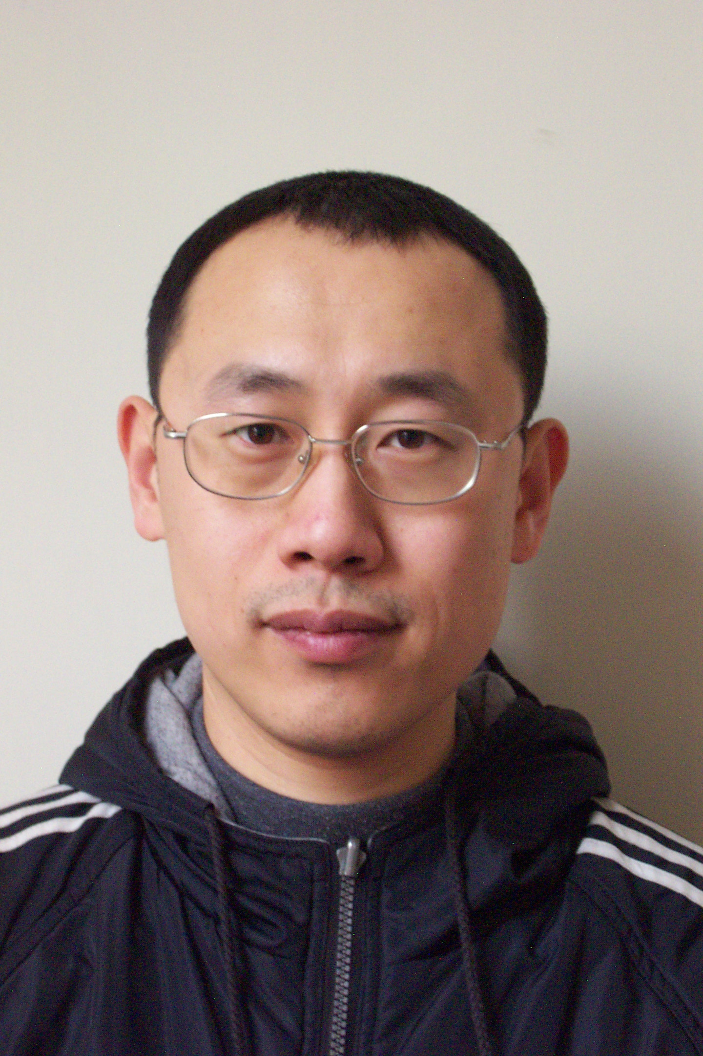
Tutor and TA
Chen Wenguang
Professor , Department of Computer Science
cwg@tsinghua.edu.cn
TA
Yunyi Chen(yy-chen19@mails.tsinghua.edu.cn)

Slide 3
1. Introduction to Big Data – A Computer System Perspective

Slide 4
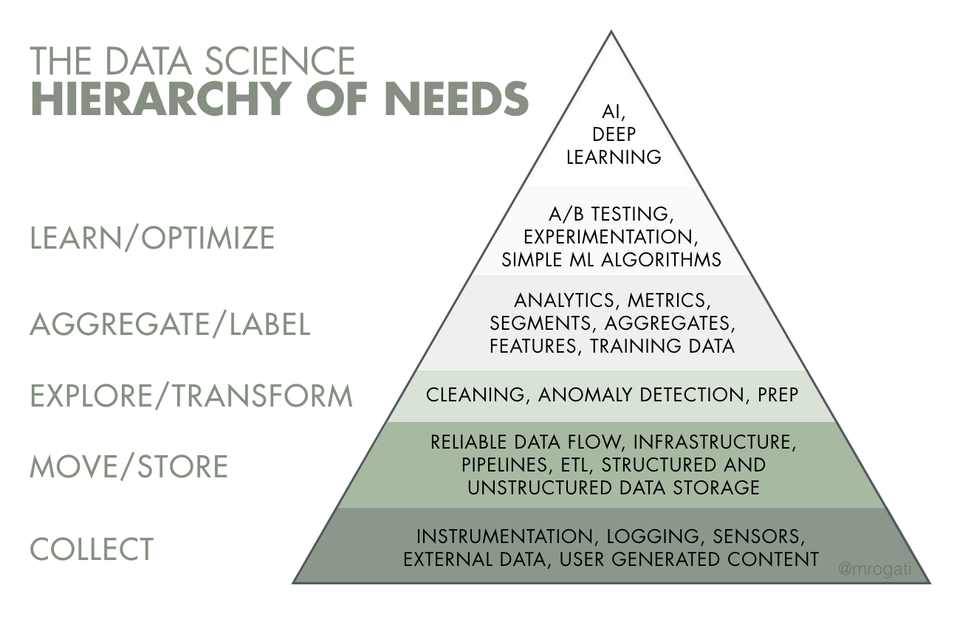
In this course, we focus on the 4 lower layers, and will touch the higher layers slightly
The AI Hierarchy of Needs
https://medium.com/hackernoon/the-ai-hierarchy-of-needs-18f111fcc007

Slide 5

Collect
User generated: inputs, clicks
2 trillion search per year
Systems generated: logs, metadata, predictions
Enterprise applications data: inventory, transaction data
e.g. Taobao : 560K transactions per second (2020/11/11)
Social Network
10B people, 1T links
Web page with links – Page Rank
1Trillion pages, 100Trillion links
3Vs: Volume，Variety，Velocity

Slide 6

Move/Store
{‘image’: [[200,155,0], [255,255,255], ...],
‘label’: ‘car’, ‘id’: 1}
Tens of Petabytes of data
Structured and unstructured
Tweets – Natural language - Unstructured
Profile / Tags : JSON formatted semi-structured data
Connections – Graph :Unstructured data

Slide 7
Various Data Format
Format | Binary/Text | Human-readable? | Example use cases
JSON | Text | Yes | Everywhere
CSV | Text | Yes | Everywhere
Parquet | Binary | No | Hadoop, Amazon Redshift
Avro | Binary primary | No | Hadoop
Protobuf | Binary primary | No | Google, TensorFlow (TFRecord)
Pickle | Text, binary | No | Python, PyTorch serialization

Slide 8
Explore/Aggregate
Local query :SQL-like queries
Iterative algorithms : WordCount, PageRank
Search log of search engine
web page with links
Social network

Slide 9
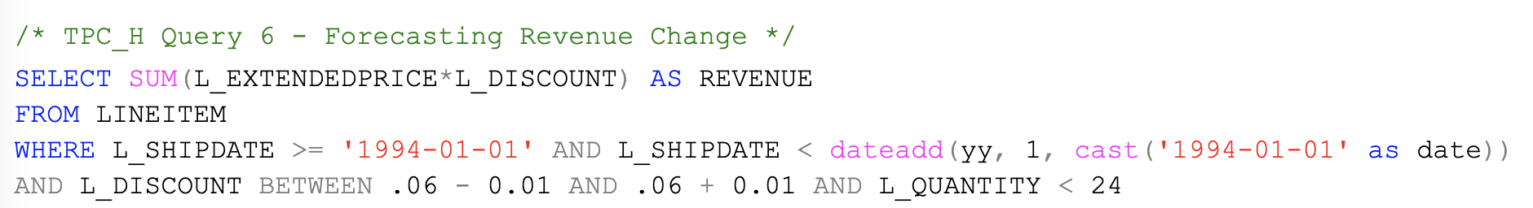
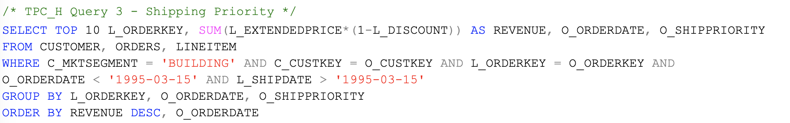
OLAP query Examples
OLAP：Online Analytical Processing

Slide 10
WordCount
Page 1: the weather is good
Page 2: today is good
Page 3: good weather is good.
(the 1)
(is 3)
(weather 2)
(today 1)
(good 4)
10

Slide 11
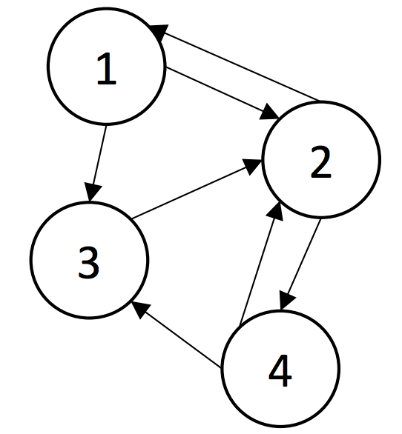
PageRank
An algorithm on graph
Vertex:
1,2,3, 4
Edges:
(1,2) (1,3)
(2,1) (2,4)
(4,2) (4,3)
For Vertex 1:
In edge: (2,1)
Out edge: (1,2) (1,3)

Slide 12
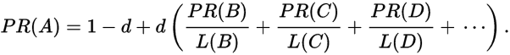
PageRank Algorithm
B
38.4
C
34.3
A
3.3
D
3.9
E
8.1
F
3.9
1.6
1.6
1.6
1.6
1.6

Slide 13
The algorithms seems simple
The challenge is on large scale of data, which coins the term “Big Data”:
Payment system
560K transactions per second (2020/11/11)
Search log of search engine - Word count
2 trillion search per year
Web page with links – Page Rank
1T pages, 100T links
Social network – follow/unfollow
10B people, 1T links

Slide 14
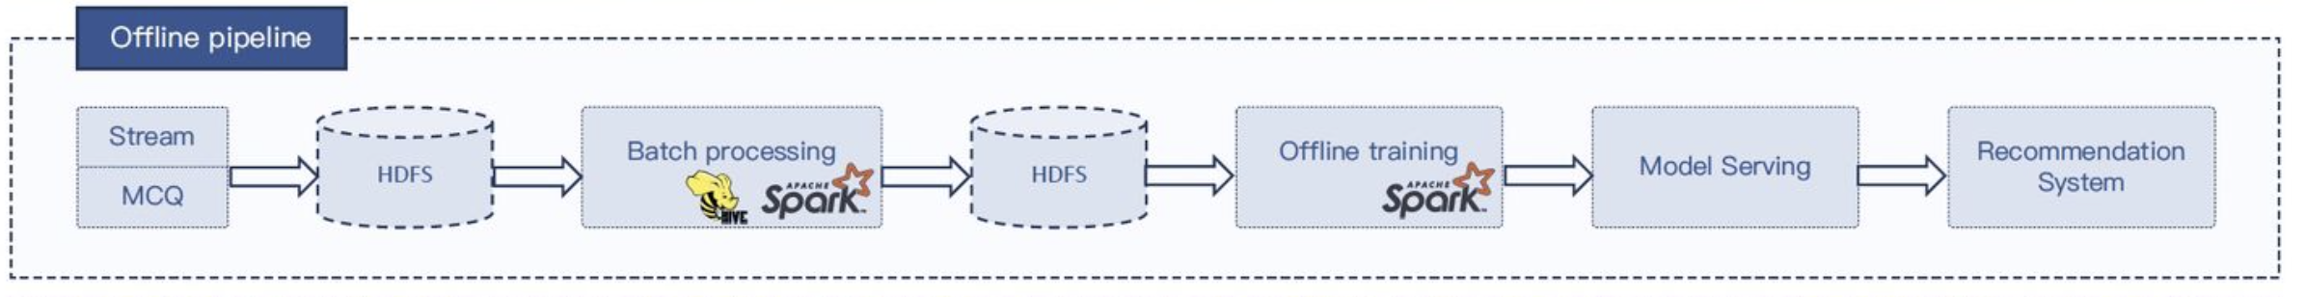
Special Systems are required to process these big data
Store big data : Distributed file systems and Key-Value stores.
Challenges: Disk failure / node failure, Throughput and (tail)latency
Process big data: e.g. Hadoop Spark, TiDB, Storm
Challenges: node failure, ease of parallel programming, efficiency
Connector : e.g. Kafka
Challenges: Node failure, Throughput

Slide 15
More realistic data pipeline
Apps
real-time
Database
(MySQL)
Queue
(Kafka)
RealTime ETL
（Flink,SPARK)
OLTP
（Hbase, KV,ES)
ETL
（Flink,Spark
+HUDI)
DataLake
（MPPDB，HDFS)
offline
Analysts
OLAP
（Presto,CK)

Slide 16
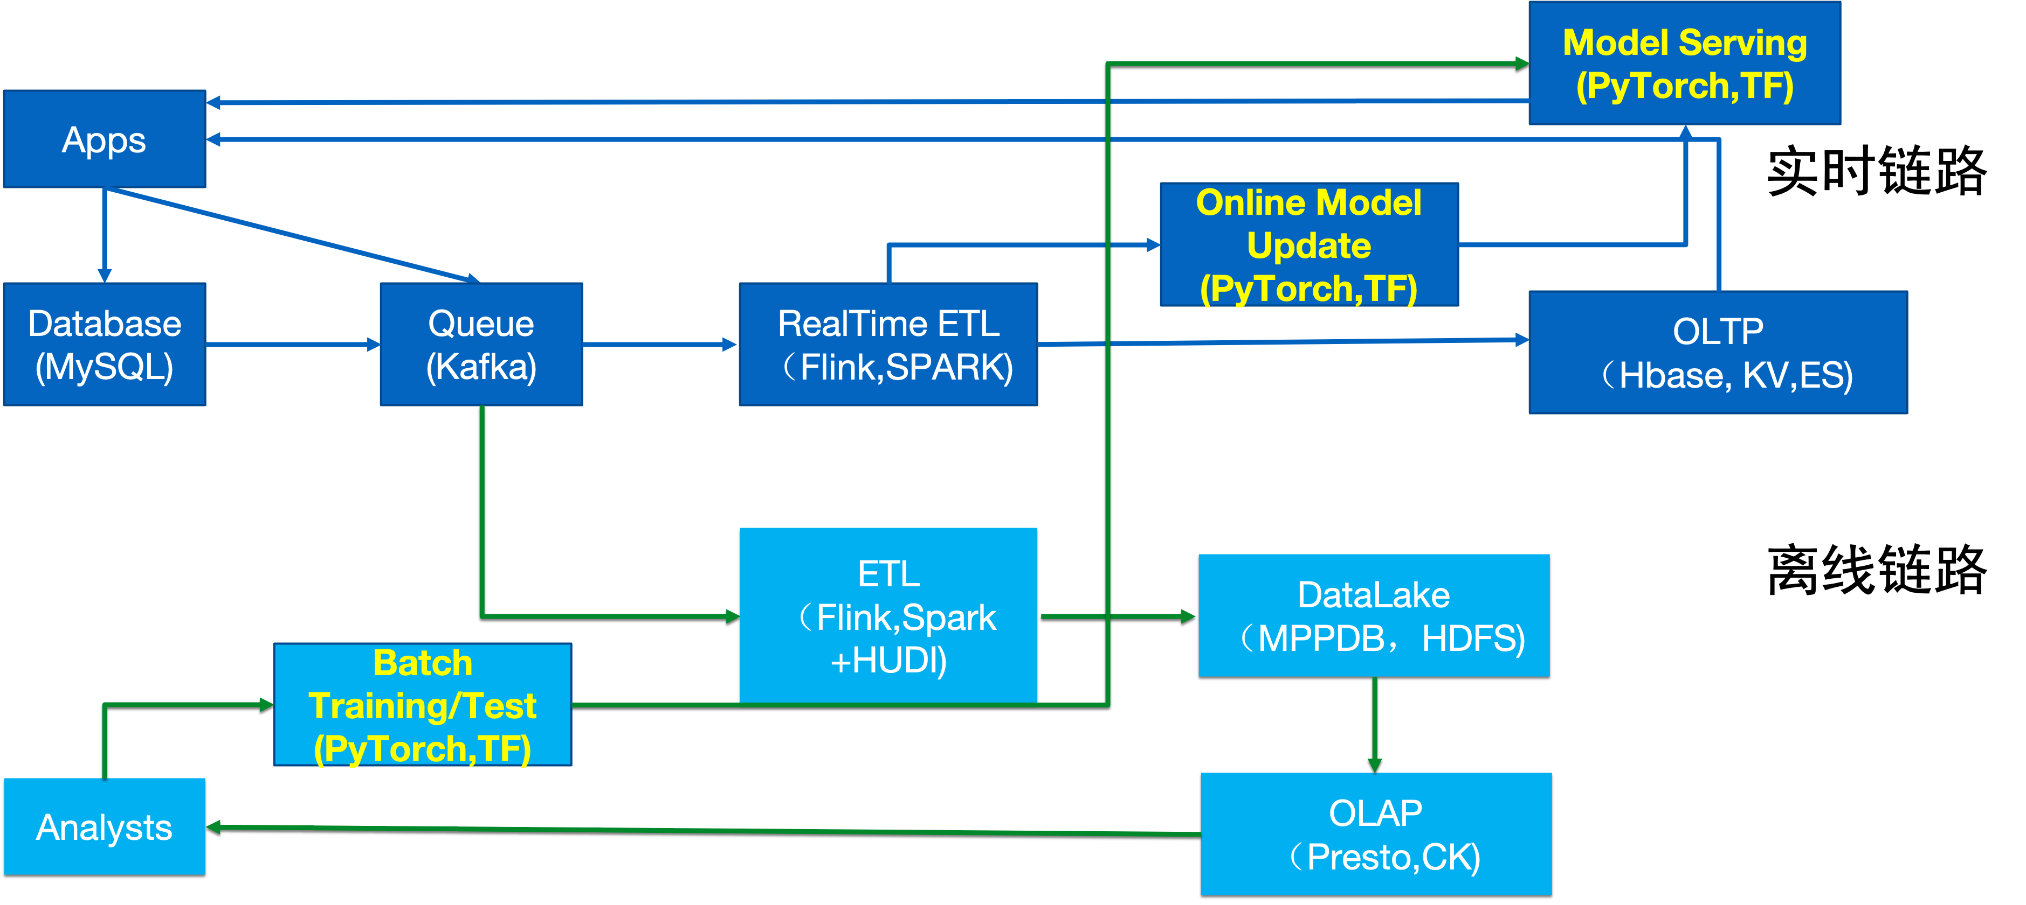
More realistic data+AI pipeline
real-time
offline

Slide 17
Hadoop Ecosystem Overview*
*Picture from:https://www.cloudera.com/products/open-source/apache-hadoop.html

Slide 18
2. Course Syllabus

Slide 19
Prerequisite courses
Programming
C / Java / Python
Very hands-on course. Quite some labs.
Although each of them is not difficult, but you should be comfortable with programming
Data structure and Algorithms
Graph algorithms such as BFS etc.
Computer architecture and operating systems
A plus for optimizing performance.
Will introduce some basic concepts that is useful to understand the big data systems in this course

Slide 20
Course structure(Tsinghua Campus)
Assignment and labs after lecturer
70 points
Labs which take 2-4 hours each week, such as
Write a MapReduce program to find shortest path of a graph
Final exam
30 points
Course Projects(Optional and extra)
10 points

Slide 21
Course structure(Global online)
Assignment and labs after lecturer
100 points
Labs which take 2-4 hours each week, such as
Write a MapReduce program to find shortest path of a graph
Course Projects(Optional and extra)
10 points

Slide 22
Main topics
PART I : Parallel Programming(2 weeks)
PART II : Big Data Storage and Processing(7 weeks)
PART III : Extended topics(4 weeks)
PART IV(optional)
Projects

Slide 23
PART I
Principles of parallel and distributed computing
Parallel computing concepts
Parallelism, load balance, fault tolerance (W1)
Traditional parallel programming paradigm(W2)
Threads, MPI ,OpenMP

Slide 24
PART II
Store Big data
HDFS(W3)
Processing Big data
Hadoop MapReduce (W4)
In memory computing: Spark(W5,W6)
Stream computing and queue (W7,W8)
Graph based framework(W9,W10)

Slide 25
PART III
Extended subjects
Distributed machine learning(W11)
Graph Neural Networks(W12)
Federated Machine Learning and MPCs(W13)
Block chain(W14)

Slide 26
PART IV(Optional)
A project to design a big data system module or an optimization extension for an existing big data system
Support SparkSQL on the core system we provided, or
Name your own projects

Slide 27
3.Principles of Parallel Computing
3.1 Why we have to do parallel computing

Slide 28
Challenges of Big data processing
Volume → More memory and I/O bandwidth
Velocity → Fast processing
Variety → More computing paradigms
Parallel computing are used to attack the Volume and Velocity at the same time

Slide 29
Impact of parallel computing
Improve the performance of data processing
But, which performance? response time or throughput?
A task to work on 1 billion 64 bit integer
Serial version : 1 s
Response time: 1s, throughput : 1 billion number /s
4 core parallel version : 0.4 s(Please note typically sublinear speedup due to the overhead introduced by parallel verison)
Response time: 0.4s, throughput : 2.5 billion number/s
But 4 copies of serial version on 4 cores
Response time: 1s, throughput: 4 billion number/s
Parallelism are used to improve response time with more resources
At the cost of
Much more complex programming
Imperfect parallel execution(later)
May reduce throughput with the same amount of resources
Do we have other ways to improve performance?

Slide 30
Impact of parallel computing
Improve the performance of data processing
But, which performance? response time or throughput?
 | Washington - Paris | mph | capacity
Boeing 747 | 6.5 hour | 610 | 470
Concord | 3 hour | 1350 | 132
The time for a single passenger to travel : response time ( latency)
The number of passengers delivered in a day: throughput

Slide 31
Impact of parallel computing
Parallelism are used to improve response time with more resources
At the cost of
Much more complex programming
Imperfect parallel execution(later)
May reduce throughput with the same amount of resources
Do we have other ways to improve performance?

Slide 32
Power and heat blocks frequency
Power and heat pressures
Total Power = V² * f * C + V * Ileakage
active power passive power
V is proportional to f at high frequency
So power is roughly proportional to f² ~ f³
Notes:
32

Slide 33
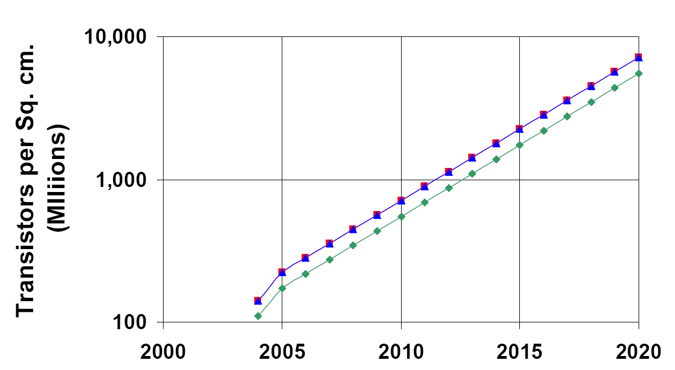
Moore’s law gives more transistors
Will Moore’s law still hold?
More transistors on chip each year
But the free frequency lunch is over
Notes:
33

Slide 34
A First order estimation on the power efficiency of a dual core processor
Assumption
Program can be perfectly parallelized
Fixed power budget
Total power is proportional to square of frequency
Assume it is independent to the number of transistors
Performance is proportional to frequency
If the performance of this program on a single core is 1 solution/s
what is the performance of this program on a dual-core chip with the same power budget?(assume perfect parallelization)

Slide 35
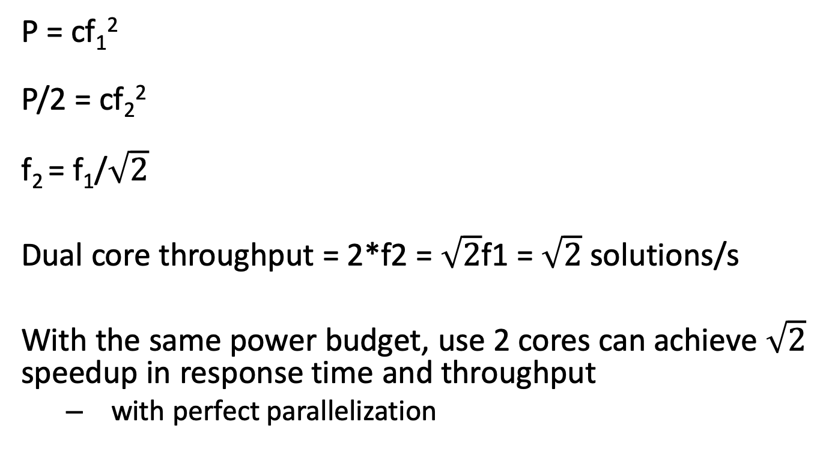
P = cf₁²
P/2 = cf₂²
f₂ = f₁/$\sqrt{2}$
Dual core throughput = 2*f2 = $\sqrt{2}$f1 = $\sqrt{2}$ solutions/s
With the same power budget, use 2 cores can achieve $\sqrt{2}$ speedup in response time and throughput
with perfect parallelization

Slide 36
3. Principles of Parallel Computing
3.2 Two laws in parallel computing

Slide 37
A Fundamental Question for Parallel Computing
Given N processors, what is the maximum speedup that a program can achieve
Note that there are sequential sections in programs ( examples?)

Slide 38
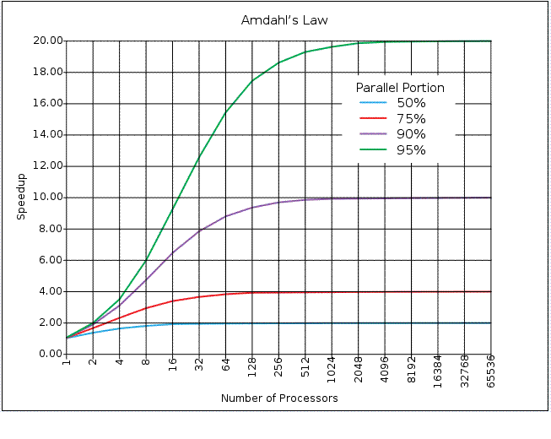
Two laws in parallel computing(1)
Amdahl’s law
If P is the proportion of a program that can be made parallel, the limit of speedup of whole program is bounded at 1/(1-P)
Notes:
38
What are the serial parts in applications?

Slide 39
Two laws in parallel computing(2)
Gustafson’s law
Amdahl’s law assume the fixed problem size
If problem size can increase as the compute power increases, the speedup that can be achieved is much larger, which is
S = a(n) + p(1-a(n))
n, problem size
p, number of processors
a(n), serial portion at problem size n
S → p when a(n) → 0
Reevaluating Amdahl's Law ,Communications of the ACM 31(5),1988. pp. 532-533
Notes:
39
Give an example that parallel part of applications increase faster than serial part

Slide 40
In the real world
Gustafson’s law rescues parallel computing
Larger machines are still useful
Many small chips can deliver good performance when the problem size is big
Blue Gene/L, Sunway TaihuLight( More than 10M cores)
However, some applications do not have bigger data set
Genome alignment, social network
What happens when fixed problem size meet Moore’s law?
Real world are mix of Amdahl’s law and Gustafson’s law
Notes:
40

Slide 41
3.Principles of Parallel Computing
3.3 Major issues of parallel computing

Slide 42
Major issues of Parallel Programming
Parallelism identification
Rely on developers to specify
May need incremental parallelization to achieve the performance target
Load balance
The completion time of a parallel program is its last thread’s completion time
Sequential sections can be viewed as extremely load imbalanced sections
Proper synchronization
Make sure the programs are parallelized correctly
Data race and deadlock free
Respect dependence of original program

Slide 43
So what is the rule behind correct parallelism?
Let’s examine it by examples.
Can following loops be parallelized?
//Loop 1
for(int i=0; i<N; i++)
{
a[i] = a[i]+1.0;
}
//Loop 2
for(int i=1; i<N; i++)
{
a[i] = a[i]+a[i-1];
}
Notes:
43

Slide 44
How Loop 2 are executed in parallel?
for(int i=1; i<=4; i++)
{
a[i] = a[i]+a[i-1];
}
A possible parallel execution of the loop:
Thread 1
a[1]=a[1]+a[0];
a[2]=a[2]+a[1];
Thread 2
a[3]=a[3]+a[2];
a[4]=a[4]+a[3];
Thread 2 may use the old a[2], before the right a[2] is calculated
44
Notes:
CS267 Lecture 2
44

Slide 45
Loop 3 and 4
//Loop 3
for(int i=0; i<4; i++)
{
a[i] = a[i] + a[i+3];
}
//Loop 4
for(int i=1; i<4; i++)
{
a[i] = a[i]+a[i+5];
}

Slide 46
Loop 5
for i = 1 to n
{
a[2*i] = b[i] + c[i];
d[i] = a[2*i-1];
}
Are there i1 and i2 such that
1 <= i1 <=i2 <= n and
2*i1 = 2*i2- 1

Slide 47
Process boundary
//Loop 3
p()
{
q(5);
}
q(int n)
{
for(int i=1; i<n; i++)
{
a[i] = a[i]+a[i+5];
}
}

Slide 48
Dependence blocks parallelization
Can not parallelize a loop unless we know there’re no cross-iteration data dependence
But aliasing and procedure boundary prevent compiler from accurate and efficient dependence test
An optimization technique called speculative parallelization, which could get the 30% of performance improvement with 4 cores
Is this a good research direction? Why?
Notes:
48

Slide 49
Voltage/Frequency of processor can be tuned
DVFS:Dynamic Voltage and Frequency Scaling
What is the implication to parallelization?

Slide 50
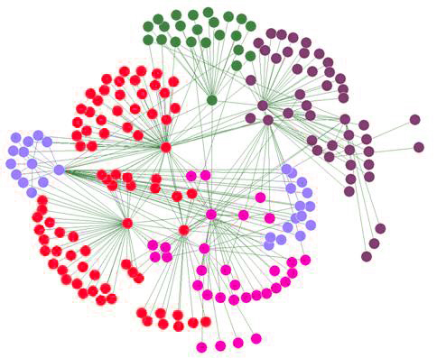
Load Balance
Both Amdahl and Gustafson’s law assume perfect parallelization.
Load imbalance is one of the most significant performance bottleneck
Speedup is damaged seriously
Scheduling loops to processors
T1
T2
T3
T4
IDLE
IDLE
IDLE
Notes:
50

Slide 51
Load balance examples
Add 1000 numbers with 10 threads
Allocate 100 numbers per thread
Count the number of word frequency in 1000 documents with 10 threads
Allocate 100 documents per thread?
Page rank on a graph with 10000 vertices with 10 threads
Allocate 1000 vertices per threads?

Slide 52
Data race example
Main
Thread
int i;
for (i = 0; i < 100; i++) {
Pthread_create(&tid, NULL,
thread, &i);
}
void *thread(void *vargp)
{
int i = *((int *)vargp);
Pthread_detach(pthread_self());
save_value(i);
return NULL;
}
Race Test
If no race, then each thread would get different value of i
Set of saved values would consist of one copy each of 0 through 99.
Notes:
Pthread_detach: No need to join to release its resources

Slide 53
Experimental Results
No Race
Single core laptop
Multicore server
The race can really happen!

Slide 54
What and Why Parallelism
Avoid parallelism if possible
Check single threaded solution first
We may have to do it for many big data problems
Keep the power issues in mind
Difficult to get parallelism correctly and efficiently
Dependences
Load balancing
Data races and deadlocks
Uncertainty

Slide 55
Q&A & break 2

Slide 56
4. Thread-based parallel programming

Slide 57
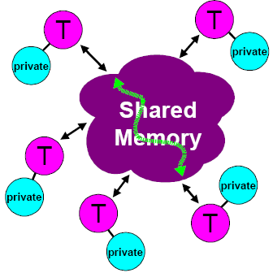
Shared Memory Programming Model
Shared Memory
Thread still may have private data
Communications are implicitly done
Synchorinization is required to makes sure that S2 should execute AFTER s3
Thread 1
s1:a = b + c
S2:g = a + f
Thread 2
S3:f = e + d
OpenMP, Pthreads
Windows Threads
Notes:
57

Slide 58
The Pthreads "hello, world" Program
/*
* hello.c - Pthreads "hello, world" program
*/
#include <pthread.h>
void *thread(void *vargp);
int main() {
pthread_t tid;
pthread_create(&tid, NULL, thread, NULL);
pthread_join(tid, NULL);
exit(0);
}
Thread attributes
(usually NULL)
Thread arguments
(void *p)
return value
(void **p)
/* thread routine */
void *thread(void *vargp) {
printf("Hello, world!\n");
return NULL;
}
Notes:
Attributes include stack size, stack address etc.

Slide 59
Execution of Threaded“hello, world”
main thread
call Pthread_create()
Pthread_create() returns
peer thread
call Pthread_join()
printf()
main thread waits for
peer thread to terminate
return NULL;
(peer thread
terminates)
Pthread_join() returns
exit()
terminates
main thread and
any peer threads

Slide 60
Posix Threads (Pthreads) Interface
Pthreads: Standard interface for ~60 functions that manipulate threads from C programs
Creating and reaping threads
pthread_create()
pthread_join()
Determining your thread ID
pthread_self()
Terminating threads
pthread_cancel()
pthread_exit()
exit() [terminates all threads] , RET [terminates current thread]
Synchronizing access to shared variables
pthread_mutex_init
pthread_mutex_[un]lock
pthread_cond_init
pthread_cond_[timed]wait

Slide 61
Examples: Calculate the sum of an array
Single threaded version
void test(int elems, int stride) {
int i, result = 0;
volatile int sink;
for (i = 0; i < elems; i += stride)
result += data[i];
sink = result;
}

Slide 62
Main threads
void *sum_thread(void *);
volatile long global_sum = 0; /* global */
main()
{
…
for (int i = 0; i < N; i++)
pthread_create(&tid[i], NULL, sum_thread, (void*)i);
for (int i = 0; i < N; i++)
pthread_join(tid[i], NULL);
}

Slide 63
Bad - Thread
void *sum_thread(void *vargp)
{
long sum;
int myid = (long) vargp;
int start = myid * sample_num / 4;
int end = (myid+1) * sample_num / 4 - 1;
sum = 0;
for (int i=start; i<=end; i++)
sum += x[i];
global_sum += sum;
return NULL;
}

Slide 64
Semaphores
Semaphore: non-negative global integer synchronization variable
Manipulated by P and V operations:
P(s): [ while (s == 0) wait(); s--; ]
Dutch for "Proberen" (test)
V(s): [ s++; ]
Dutch for "Verhogen" (increment)
OS kernel guarantees that operations between brackets [ ] are executed indivisibly
Only one P or V operation at a time can modify s.
When while loop in P terminates, only that P can decrement s
Semaphore invariant: (s >= 0)
Notes:
The concept of automicity.
Can be implemented with compare and swap instructions， CMPEXCHG

Slide 65
C Semaphore Operations
Pthreads functions:
#include <semaphore.h>
int sem_init(sem_t *sem, 0, unsigned int val);} /* s = val */
int sem_wait(sem_t *s); /* P(s) */
int sem_post(sem_t *s); /* V(s) */

Slide 66
Good - Thread
void *sum_thread(void *vargp)
{
long sum;
int myid = (long) vargp;
int start = myid * sample_num / 4;
int end = (myid+1) * sample_num / 4 - 1;
sum = 0;
for (int i=start; i<=end; i++)
sum += x[i];
sem_wait(&num_mutex);
global_sum += sum;
sem_post(&num_mutex);
return NULL;
}

Slide 67
Pthread Summary
Programmers need a clear model of how variables are shared by threads.
Variables shared by multiple threads must be protected to ensure mutually exclusive access.
Semaphores are a fundamental mechanism for enforcing mutual exclusion.

Slide 68
Issues with Pthreads
Flexible and powerful
Useful not only in data processing, but also in a wide range of systems
Network server etc.
Complex for data processing
Pthread is not always portable( e.g. Windows )
Code to calculate addresses and loop bounds
May not be easy to specify scheduling schemes

Slide 69
Q&A & break 3

Slide 70
5. OpenMP Parallel Programming
5.1 Express parallelism

Slide 71
Introduction to OpenMP
What is OpenMP?
Open specification for Multi-Processing [Short Version]
“Standard” API for defining multi-threaded shared-memory programs
openmp.org – Talks, examples, forums, etc.
computing.llnl.gov/tutorials/openMP/
See parlab.eecs.berkeley.edu/2012bootcampagenda
2 OpenMP lectures (slides and video) by Tim Mattson
portal.xsede.org/online-training
www.nersc.gov/assets/Uploads/XE62011OpenMP.pdf
High-level API
Preprocessor (compiler) directives ( ~ 80% )
Library Calls ( ~ 19% )
Environment Variables ( ~ 1% )
Notes:
Motivated by simplifying pThreads
Latest version 4.0, July 2013
Won’t do all details, lots of on-line material,
Homework will give you working code to modify
Directives: hints to compiler (look like comments) about what to parallelize
Can run sequentially, comments “parallelize following loop” are ignored
Some library calls to do specific functions in parallel
get, set #threads, get thread#,
Environment variables: hints like how many processors do I have.

Slide 72
A Programmer’s View of OpenMP
OpenMP is a portable, threaded, shared-memory programming specification with “light” syntax
Exact behavior depends on OpenMP implementation!
Requires compiler support (C, C++ or Fortran)
OpenMP will:
Allow a programmer to separate a program into serial regions and parallel regions, rather than T concurrently-executing threads.
Hide stack management
Provide synchronization constructs
OpenMP will not:
Parallelize automatically
Guarantee speedup
Provide freedom from data races
Notes:
Meant to run without change sequentially (hints treated as comments)
Hide stack management: i.e. figure out how to deal with private vs shared variables

Slide 73
Execution Model of OpenMP
Master Thread
Parallel Regions
Notes:
OpenMP需要支持哪些功能？
1 定义并行区
2 设置并行度
3 并行结构
4 并行区数据管理
5 同步机制

Slide 74
HelloWorld of OpenMP
#include <omp.h>
#include <stdio.h>
int main()
{
#pragma omp parallel
{
int id = omp_get_thread_num();
printf("Hello World %d!\n", id);
}
}

Slide 75
Compile and Run
$ brew install libomp
$ clang -Xpreprocessor -fopenmp -lomp –o hello hello.c
$ ./hello
Hello World 0!
Hello World 7!
Hello World 3!
Hello World 4!
Hello World 5!
Hello World 2!
Hello World 1!
Hello World 6!

Slide 76
HelloWorld 2
#include <omp.h>
#include <stdio.h>
int main()
{
#pragma omp parallel
{
int id = omp_get_thread_num();
printf("Hello%d!\n", id);
printf("World%d!\n", id);
}
}

Slide 77
$ ./hello2
Hello0!
World0!
Hello5!
World5!
Hello2!
Hello6!
World6!
Hello1!
World1!
World2!
Hello4!
World4!
Hello7!
World7!
Hello3!
World3!

Slide 78
SPMD and Worksharing
SPMD : Each thread execute the code in {}
#pragma omp parallel
{
int id = omp_get_thread_num();
printf("Hello%d!\n", id);
}
Worksharing : Each thread execute part of loop
#pragma omp parallel
{
#pragma omp for
for (i = 1; i < 13; i ++)
{
printf("Hello %d!\n", i);
}
}

Slide 79
Parallel Loop
int main()
{
int i;
#pragma omp parallel
{
#pragma omp for
for (i = 1; i < 13; i ++)
{
printf("Hello %d!\n", i);
}
}
}

Slide 80
$ ./loop
Hello 1!
Hello 2!
Hello 11!
Hello 12!
Hello 9!
Hello 7!
Hello 8!
Hello 5!
Hello 10!
Hello 3!
Hello 4!
Hello 6!

Slide 81
int main()
{
int i;
#pragma omp parallel
{
#pragma omp for
for (i = 1; i < 13; i ++)
{
printf("Hello %d!\n", i);
}
}
}
int main()
{
int i;
#pragma omp parallel for
for (i = 1; i < 13; i ++)
{
printf("Hello %d!\n", i);
}
}

Slide 82
OpenMP Array Sum Example
void test(int elems, int stride) {
int i, result = 0;
volatile int sink;
#pragma omp parallel for
for (i = 0; i < elems; i += stride)
result += data[i];
sink = result;
}

Slide 83
Work-sharing Construct - loop
Threads are assigned an independent set of iterations
Threads must wait at the end of work-sharing construct
#pragma omp parallel
#pragma omp for
i = 1
i = 2
i = 3
i = 4
i = 5
i = 6
i = 7
i = 8
i = 9
i = 10
i = 11
i = 12
#pragma omp parallel for
for(i = 1, i < 13, i++)
c[i] = a[i] + b[i]
Implicit barrier

Slide 84
5. OpenMP Parallel Programming
5.2 Data Sharing

Slide 85
Programming Model – Data Sharing
Parallel programs often employ two types of data
Shared data, visible to all threads, similarly named
Private data, visible to a single thread (often stack-allocated)
// shared, globals
int bigdata[1024];
void* foo(void* bar) {
// private, stack
int tid;
/* Calculation goes
here */
}
PThreads:
Global-scoped variables are shared
Stack-allocated variables are private

Slide 86
Programming Model – Data Sharing
Parallel programs often employ two types of data
Shared data, visible to all threads, similarly named
Private data, visible to a single thread (often stack-allocated)
int bigdata[1024];
void* foo(void* bar) {
int tid;
#pragma omp parallel \
shared ( bigdata ) \
private ( tid )
{
/* Calc. here */
}
}
PThreads:
Global-scoped variables are shared
Stack-allocated variables are private
OpenMP:
shared variables are shared
private variables are private
Rules for default
Notes:
How the tid act before and after the parallel construct?

Slide 87
Data Environment
OpenMP uses a shared-memory programming model
Most variables are shared by default.
Global variables are shared among threads
C/C++: File scope variables, static

Slide 88
Data Environment
Implicit rules...
Stack variables in functions called from parallel regions are PRIVATE
Automatic variables within a statement block are PRIVATE
C/C++: The first loop index variable in nested loops following a #pragma omp for is private
Notes:
Fortran will make all nested loop indices private.

Slide 89
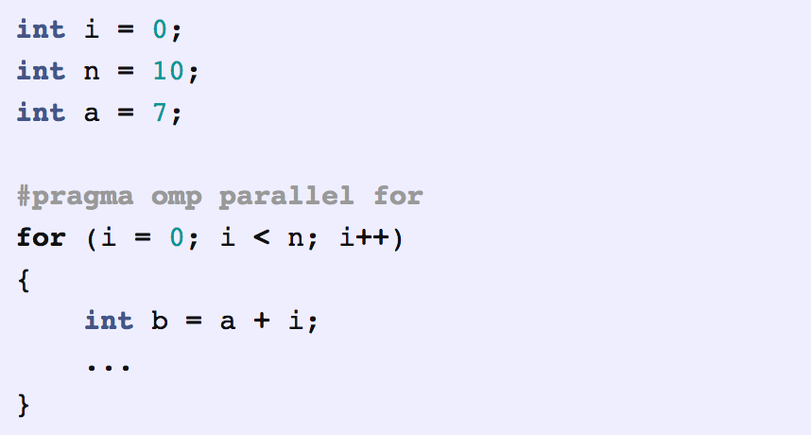
n and a are shared. i and b are private.

Slide 90
Data Scope Attributes
The default status can be modified with
default (shared | none)
Scoping attribute clauses
shared(varname,…)
private(varname,…)
Notes:
Data Scope Attributes
All data clauses apply to parallel regions and worksharing constructs except “shared,” which only applies to parallel regions.

Slide 91
The Private Clause
Reproduces the variable for each thread
Variables are un-initialized;
C++ object is default constructed
Any value external to the parallel region is undefined
void* work(float* c, int N) {
float x, y; int i;
#pragma omp parallel for private(x,y)
for(i=0; i<N; i++) {
x = a[i]; y = b[i];
c[i] = x + y;
}
}
Notes:
为什么要private的原因，和例子
Private Cause
For-loop iteration variable is PRIVATE by default.

Slide 92
Examples of private
#include <omp.h>
#include <stdio.h>
int main()
{
int sum = 0;
#pragma omp parallel for private(sum)
for (int i = 1; i <= 10; i ++)
{
sum += i;
printf("In iteration %d, sum is %d!\n", i, sum);
}
printf("After the loop, sum is %d\n", sum);
}

Slide 93
In iteration 1, sum is 2!
In iteration 2, sum is 4!
In iteration 5, sum is 32724!
In iteration 9, sum is 32728!
In iteration 10, sum is 32729!
In iteration 8, sum is 32727!
In iteration 3, sum is 32722!
In iteration 4, sum is 32726!
In iteration 7, sum is 32726!
In iteration 6, sum is 32725!
After the loop, sum is 0
It is obviously the sum is not initialized in parallel threads, how to initialize it?

Slide 94
Firstprivate
#include <omp.h>
#include <stdio.h>
int main()
{
int sum = 0;
#pragma omp parallel for firstprivate(sum)
for (int i = 1; i <= 10; i ++)
{
sum += i;
printf("In iteration %d, sum is %d!\n", i, sum);
}
printf("After the loop, sum is %d\n", sum);
}
Initialize private variables from the master threads

Slide 95
In iteration 8, sum is 8!
In iteration 1, sum is 1!
In iteration 2, sum is 3!
In iteration 9, sum is 9!
In iteration 6, sum is 6!
In iteration 3, sum is 3!
In iteration 4, sum is 7!
In iteration 10, sum is 10!
In iteration 7, sum is 7!
In iteration 5, sum is 5!
After the loop, sum is 0
Guess how many thread are used? How the loop iterations are distributed?
We still don’t have the value of sum passed out of the loop,how?

Slide 96
lastprivate
#include <omp.h>
#include <stdio.h>
int main()
{
int sum = 0;
#pragma omp parallel for firstprivate(sum) lastprivate(sum)
for (int i = 1; i <= 10; i ++)
{
sum += i;
printf("In iteration %d, sum is %d!\n", i, sum);
}
printf("After the loop, sum is %d\n", sum);
}
Pass the value of a private from the last iteration to global variable

Slide 97
$ ./lastprivate
In iteration 3, sum is 3!
In iteration 4, sum is 7!
In iteration 10, sum is 10!
In iteration 5, sum is 5!
In iteration 7, sum is 7!
In iteration 9, sum is 9!
In iteration 8, sum is 8!
In iteration 1, sum is 1!
In iteration 2, sum is 3!
In iteration 6, sum is 6!
After the loop, sum is 10
It does give us the value from the last iteration, but not something we expected..., we need the sum to be shared indeed

Slide 98
Change to shared
float dot_prod(float* a, float* b, int N)
{
float sum = 0.0;
#pragma omp parallel for shared(sum)
for(int i=0; i<N; i++) {
sum += a[i] * b[i];
}
return sum;
}
What is Wrong?
Notes:
详细解释原因
Multiple threads modifying sum with no protection

Slide 99
In iteration 8, sum is 8!
In iteration 1, sum is 1!
In iteration 2, sum is 34!
In iteration 7, sum is 13!
In iteration 5, sum is 6!
In iteration 9, sum is 22!
In iteration 6, sum is 22!
In iteration 10, sum is 32!
In iteration 3, sum is 16!
In iteration 4, sum is 38!
After the loop, sum is 38

Slide 100
Q&A & break 4

Slide 101
5. OpenMP Parallel Programming
5.3 Critical sections and Reduction

Slide 102
OpenMP Critical Construct
#pragma omp critical [(lock_name)]
Defines a critical region on a structured block
float RES;
#pragma omp parallel
{ float B;
#pragma omp for private(B) for(int i=0; i<niters; i++){
B = big_job(i);
#pragma omp critical
{
consum (B, RES);
}
} }
Threads wait their turn –at a time, only one calls consum() thereby protecting RES from race conditions

Slide 103
Protect Shared Data
Must protect access to shared, modifiable data
float dot_prod(float* a, float* b, int N)
{
float sum = 0.0;
#pragma omp parallel for shared(sum)
for(int i=0; i<N; i++) {
#pragma omp critical
sum += a[i] * b[i];
}
return sum;
}
This makes the result correct, but not a very successful parallel program. How fast(slow) is this code?

Slide 104
Review what we have done with PThreads
volatile long global_sum = 0; /* global */
void *sum_thread(void *vargp)
{
long sum;
int myid = (long) vargp;
int start = myid * sample_num / 4;
int end = (myid+1) * sample_num / 4 - 1;
sum = 0;
for (int i=start; i<=end; i++)
sum += x[i];
sem_wait(&num_mutex);
global_sum += sum;
sem_post(&num_mutex);
return NULL;
}
Do we have a better way in OpenMP?

Slide 105
OpenMP Reduction Clause
reduction (op : list)
The variables in “list” must be shared in the enclosing parallel region
Inside parallel or work-sharing construct:
A PRIVATE copy of each list variable is created and initialized depending on the “op”
These copies are updated locally by threads
At end of construct, local copies are combined through “op” into a single value and combined with the value in the original SHARED variable
Notes:
机理和优势

Slide 106
C/C++ Reduction Operations
A range of associative operands can be used with reduction
Initial values are the ones that make sense mathematically
Operand | Initial Value
+ | 0
* | 1
- | 0
^ | 0
Operand | Initial Value
& | ~0
| | 0
&& | 1
|| | 0

Slide 107
Sum of an Array
#include <omp.h>
#include <stdio.h>
int main()
{
int sum = 0;
#pragma omp parallel for reduction(+:sum)
for (int i = 1; i <= 10; i ++)
{
sum += i;
printf("In iteration %d, sum is %d!\n", i, sum);
}
printf("After the loop, sum is %d\n", sum);
}

Slide 108
OpenMP example: Pi calculation
1
∫
4.0
4.0
dx = π
(1+x²)
0
static long num_steps = 100000;
double step;
void main ()
{ int I;
double x, pi, sum = 0.0;
step = 1.0/(double) num_steps;
for (i=0; i< num_steps; i++){
x = (i+0.5)*step;
sum = sum + 4.0/(1.0+x*x);
}
pi = step * sum;
}
2.0
F(x) = 4.0/(1+x²)
0.0
1.0
X

Slide 109
static long num_steps = 100000;
double step;
void main ()
{ int I;
double x, pi, sum = 0.0;
step = 1.0/(double) num_steps;
#pragma omp parallel for reduction(+:sum) private(x)
for (i=0; i< num_steps; i++){
x = (i+0.5)*step;
sum = sum + 4.0/(1.0+x*x);
}
pi = step * sum;
}

Slide 110
5. OpenMP Parallel Programming
5.4 Scheduling policies

Slide 111
Assigning Iterations
The schedule clause affects how loop iterations are mapped onto threads
schedule(static [,chunk])
Blocks of iterations of size “chunk” to threads
Round robin distribution
Default=N/t
schedule(dynamic[,chunk])
Threads grab “chunk” iterations
When done with iterations, thread requests next set
Default=1
schedule(guided[,chunk])
Dynamic schedule starting with large block
Size of the blocks shrink; no smaller than “chunk”
Default=1
schedule(runtime)
OMP_SCHEDULE

Slide 112
Schedule Clause Example
#pragma omp parallel for schedule (static)
for( int i = 1; i <= 128; i ++ )
{
if ( TestForPrime(i) ) gPrimesFound++;
}
#pragma omp parallel for schedule (static, 8)
for( int i = 1; i <= 128; i ++ )
{
if ( TestForPrime(i) ) gPrimesFound++;
}
#pragma omp parallel for schedule (dynamic)
for( int i = 1; i <= 128; i ++ )
{
if ( TestForPrime(i) ) gPrimesFound++;
}
Notes:
For Fortran example TestForPrime is a LOGICAL function. This example has an increasing amount of work as the iteration counter gets larger. That is because testing numbers for primality with a brute force method takes longer to work since there are more numbers to test.
C example uses STATIC scheduling. Set of iterations is divided up into chunks of size 8 and distributed to threads in round robin fashion.
Fortran example uses DYNAMIC scheduling. Chunks of 8 iterations are scheduled to threads when more work is needed by a thread.

Slide 113
Static Scheduling
For N_{i} iterations and N_{t} threads, each thread gets one chunk of N_{i}/N_{t} loop iterations:
T0 T1 T2 T3 T4 T5
Thread #0: iterations 0 through N_{i}/N_{t}-1
Thread #1: iterations N_{i}/N_{t} through 2N_{i}/N_{t}-1
Thread #2: iterations 2N_{i}/N_{t} through 3N_{i}/N_{t}-1
…
Thread #N_{t}-1: iterations (N_{t}-1)N_{i}/N_{t} through N_{i}-1

Slide 114
Dynamic Scheduling
For N_{i} iterations and N_{t} threads, each thread gets a fixed-size chunk of k loop iterations:
T0 T1 T2 T3 T4 T5 T2 T3 T4 T0 T1 T5 T3 T2
When a particular thread finishes its chunk of iterations, it gets assigned a new chunk. So, the relationship between iterations and threads is nondeterministic.
Advantage: very flexible
Disadvantage: high overhead – lots of decision making about which thread gets each chunk

Slide 115
Guided Scheduling
For N_{i} iterations and N_{t} threads, initially each thread gets a fixed-size chunk of k < N_{i}/N_{t} loop iterations:
T0 T1 T2 T3 T4 T5 2 3 4 1 0 2 5 4 2 3 1
After each thread finishes its chunk of k iterations, it gets a chunk of k/2 iterations, then k/4, etc. Chunks are assigned dynamically, as threads finish their previous chunks.
Advantage over static: can handle imbalanced load
Advantage over dynamic: fewer decisions, so less overhead

Slide 116
Scheduling in OpenMP
Schedule Clause | When To Use
STATIC | Predictable and similar work per iteration
DYNAMIC | Unpredictable, highly variable work per iteration
GUIDED | Special case of dynamic to reduce scheduling overhead

Slide 117
Thanks

